Slide 1
Explorateroy analysis using MTA data
By: Modhi Alhbrdi and Randa Almohammadi

Slide 2
INTRODUCTION
DATA:
- MTA turnstile Data (Nov. , Dec. 2018 ,and Jan. 2019)
PROBLEM STATEMENT:
- Crowded stations
- Bordeness
- Take advantage of stations.
THE IDEA:
- Entertaining Shows
- Advertising.
- Campaign.

Slide 3
Approach & Methodology
Approach and Methodology
Approach and Methodology
Methods:
-Data Cleaning
-Data Analysis
-Data Visualization
Tools:
-Python
(Numpy, Pandas, Matplot ,datetime and seaborn )

Slide 4
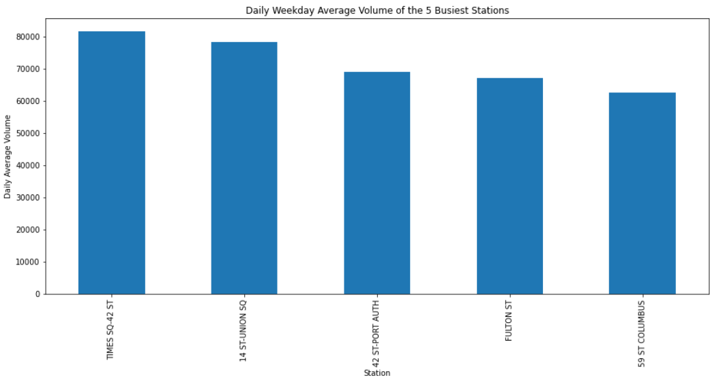
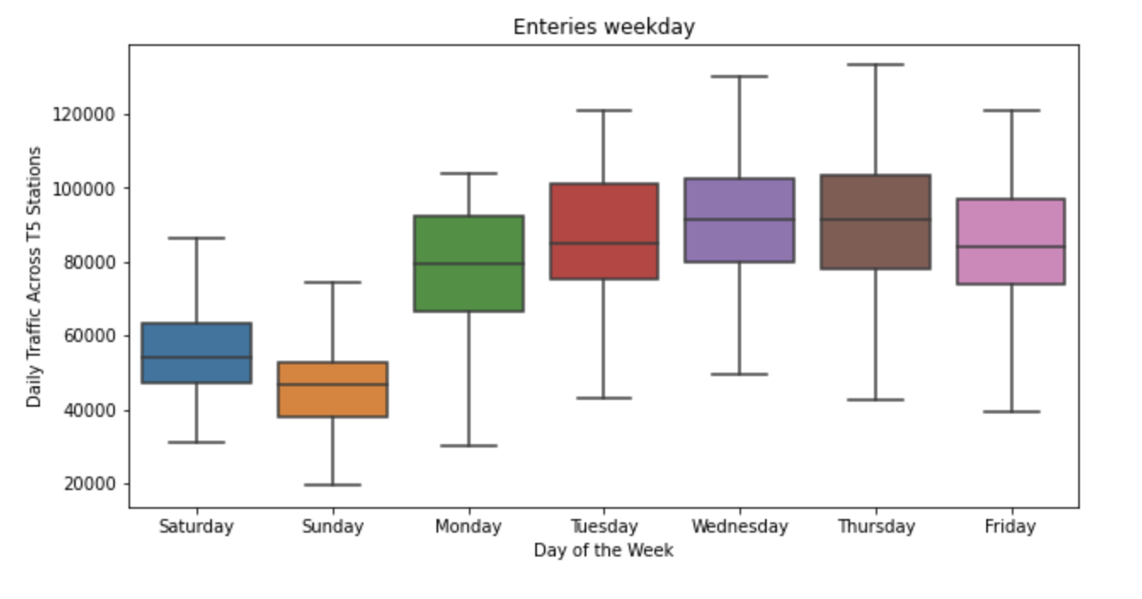
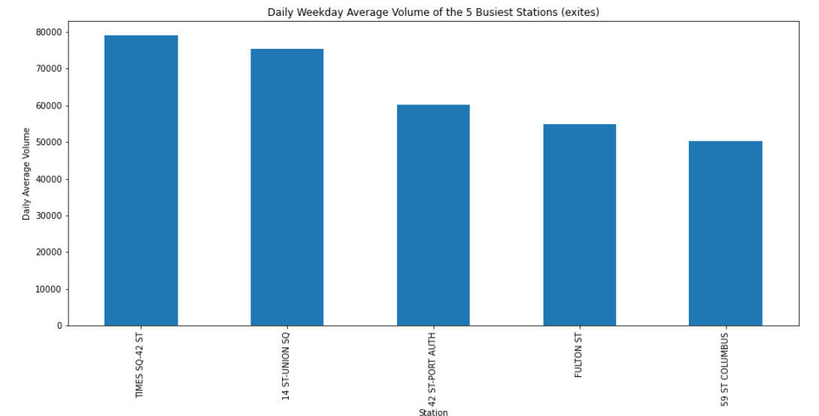
Analysis

Slide 5
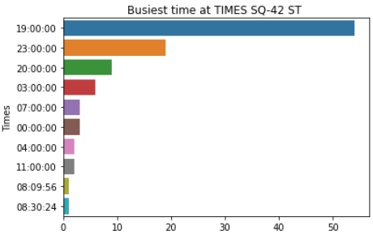
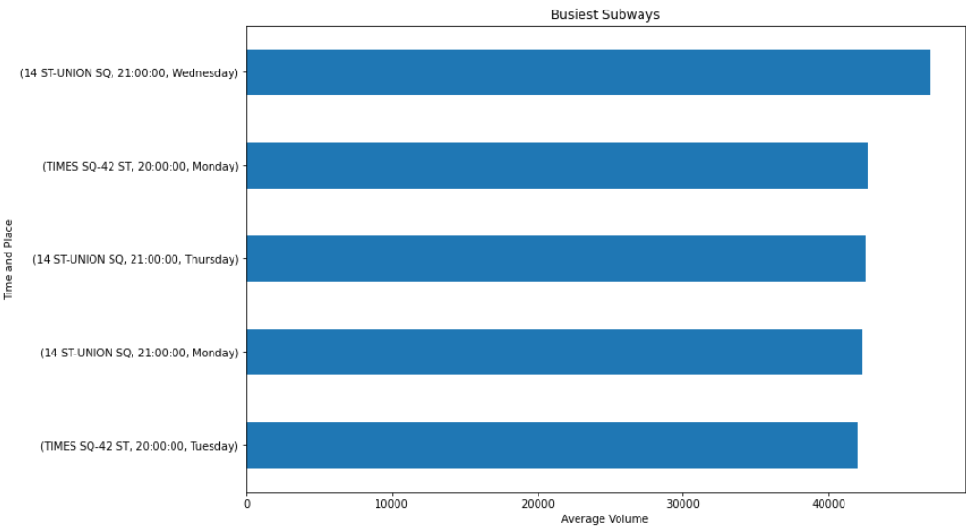
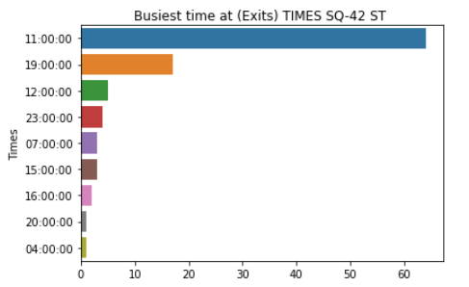
Results

Slide 6
Recommendation & CONCLUSION
Through analysis we are able to provide suggestions serve many sectors which are business, community, social responibility.
TRAFFIC: Top 5 staions Day of the week Specific hour of day.
The activities specific for the time of the day

